Slide 1
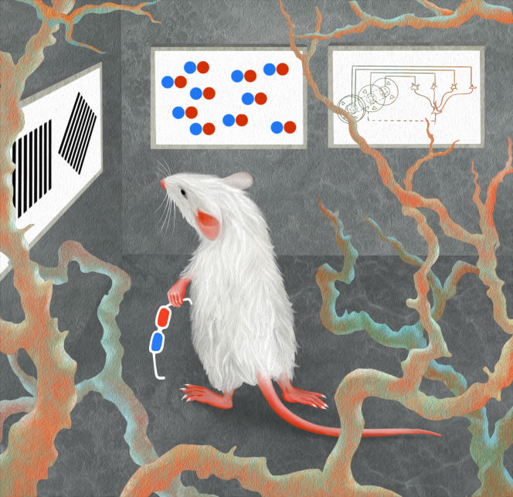
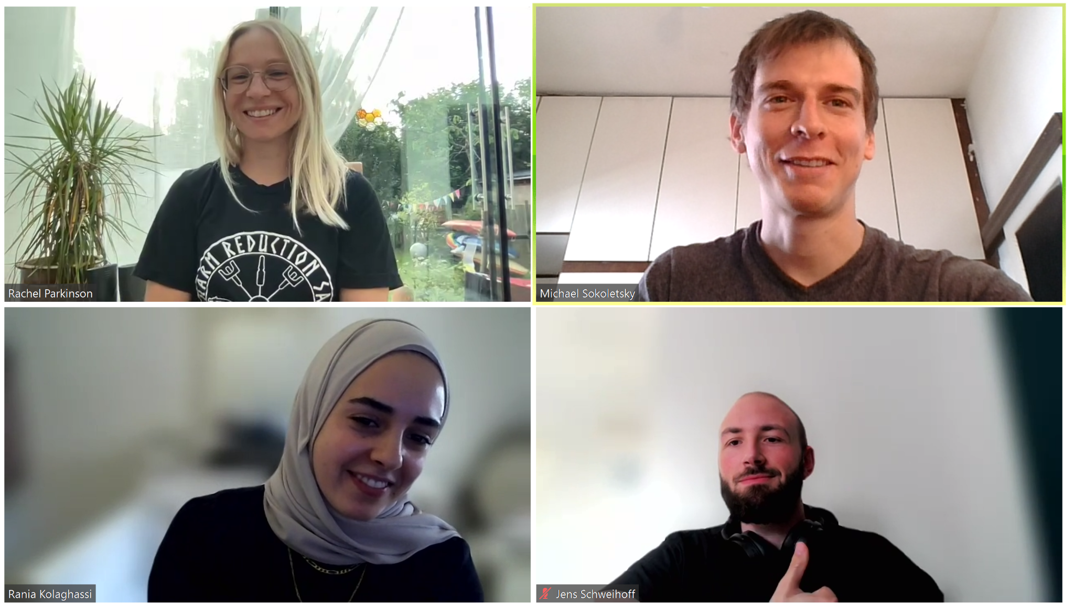


Neural Correlates of Detection in the Mouse Brain
By:
Rachel Parkinson
Michael Sokoletsky
Rania Kolaghassi
Jens Schweihoff
The Arcade Saccade

Slide 2
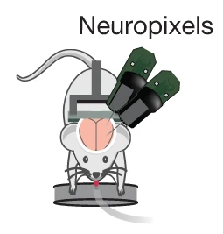
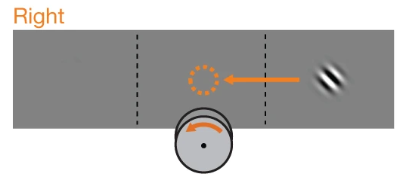
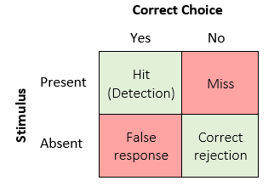
Our driving question
Action/choice
Steinmetz et al. analyze activity that occurs after a visual stimulus or after a mouse makes a specific choice.
Visual stimulus
(contra side only)
Is there additional activity that occurs when a mouse both sees a stimulus and responds to it correctly?
Adapted from Steinmetz et al. 2019
We will call such hypothetical activity the neural correlates of detection. We want to find if it exists, and if so, where.

Slide 3
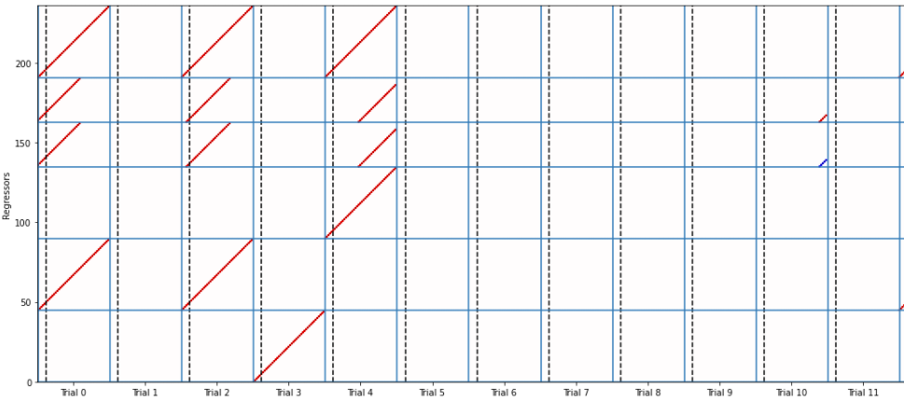
Design matrix
Ridge(): Linear least squares with l2 regularization.
Detection Event
Detection
No Response
Action
No Visual Stimulus
Choice
100%
Incorrect Action
Contrast
Visual stim onset
50%
Regression Window
25%
X_design = 1
X_design = -1

Slide 4
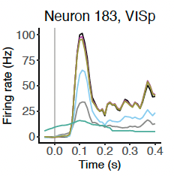
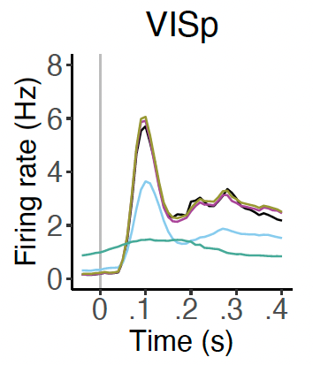
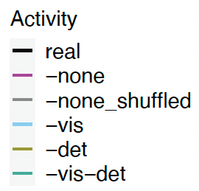
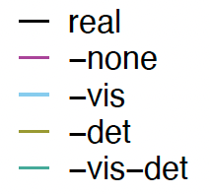
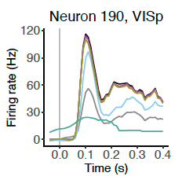
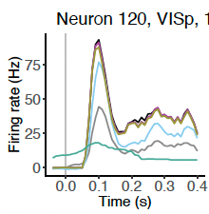
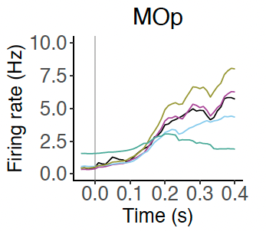
Model predictions versus real data
Single neuron model predictions
Mean responses across brain region

Slide 5
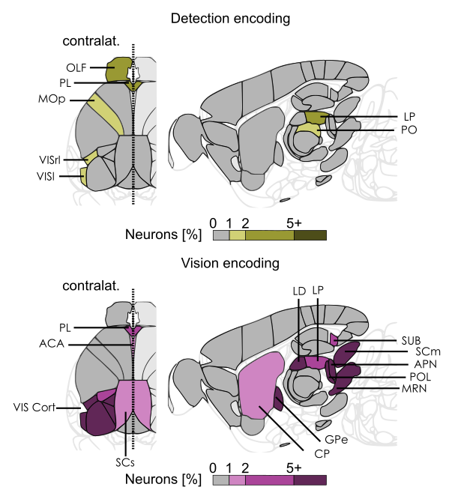
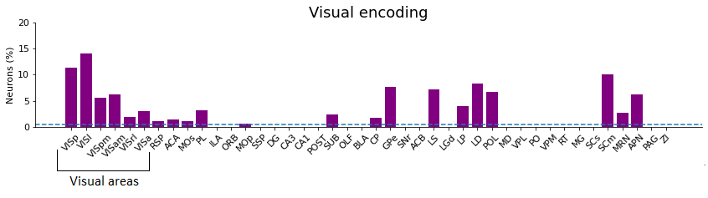
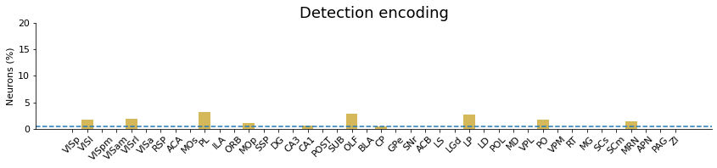
Percent encoding neurons across brain regions
Adapted from Steinmetz et al. 2019

